Slide 1


www.elsa-support.co.uk

Slide 2
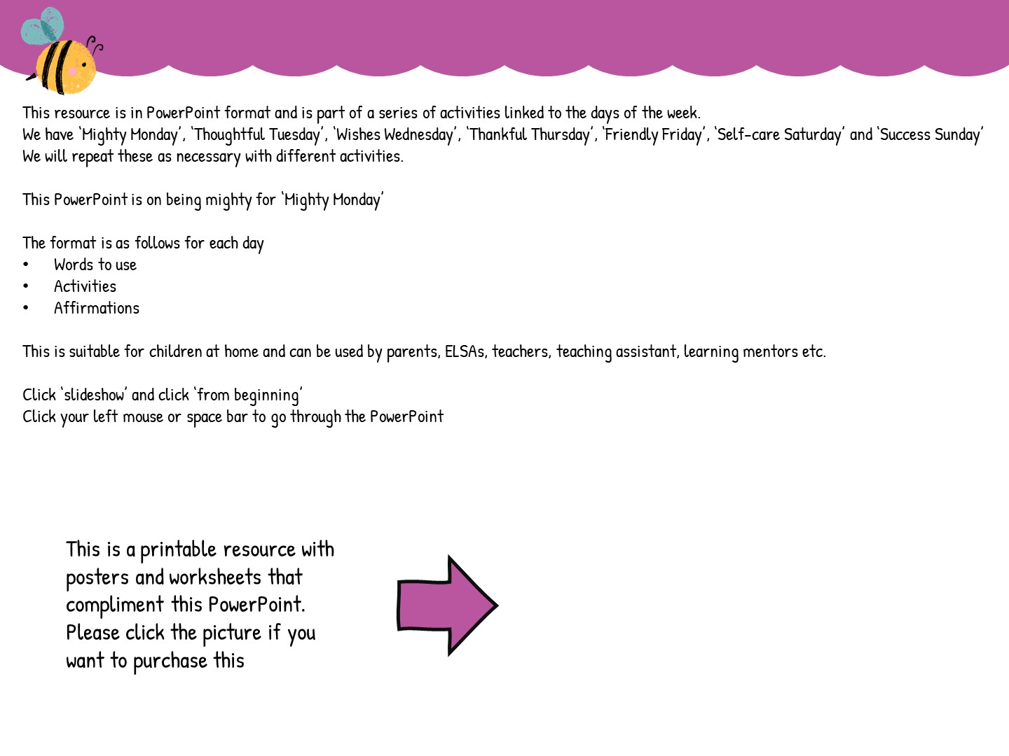


Slide 3


Slide 4


Slide 5
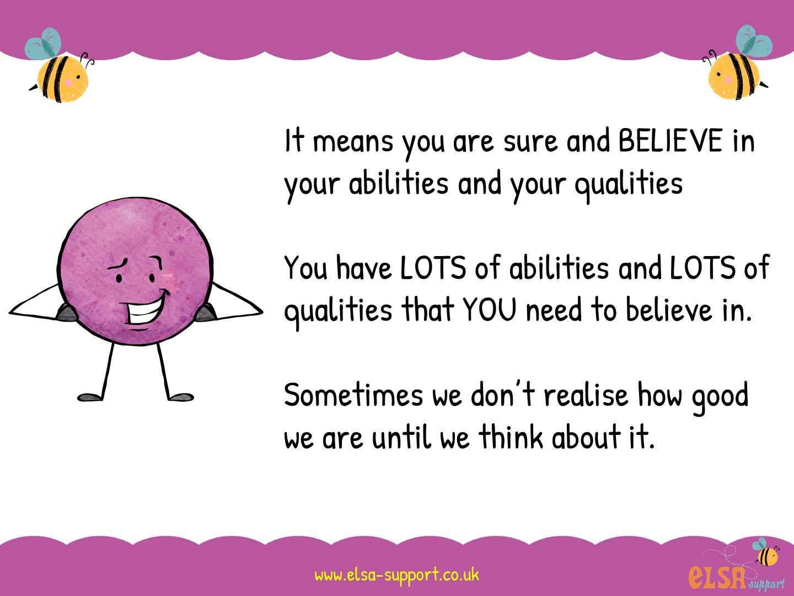

Slide 6
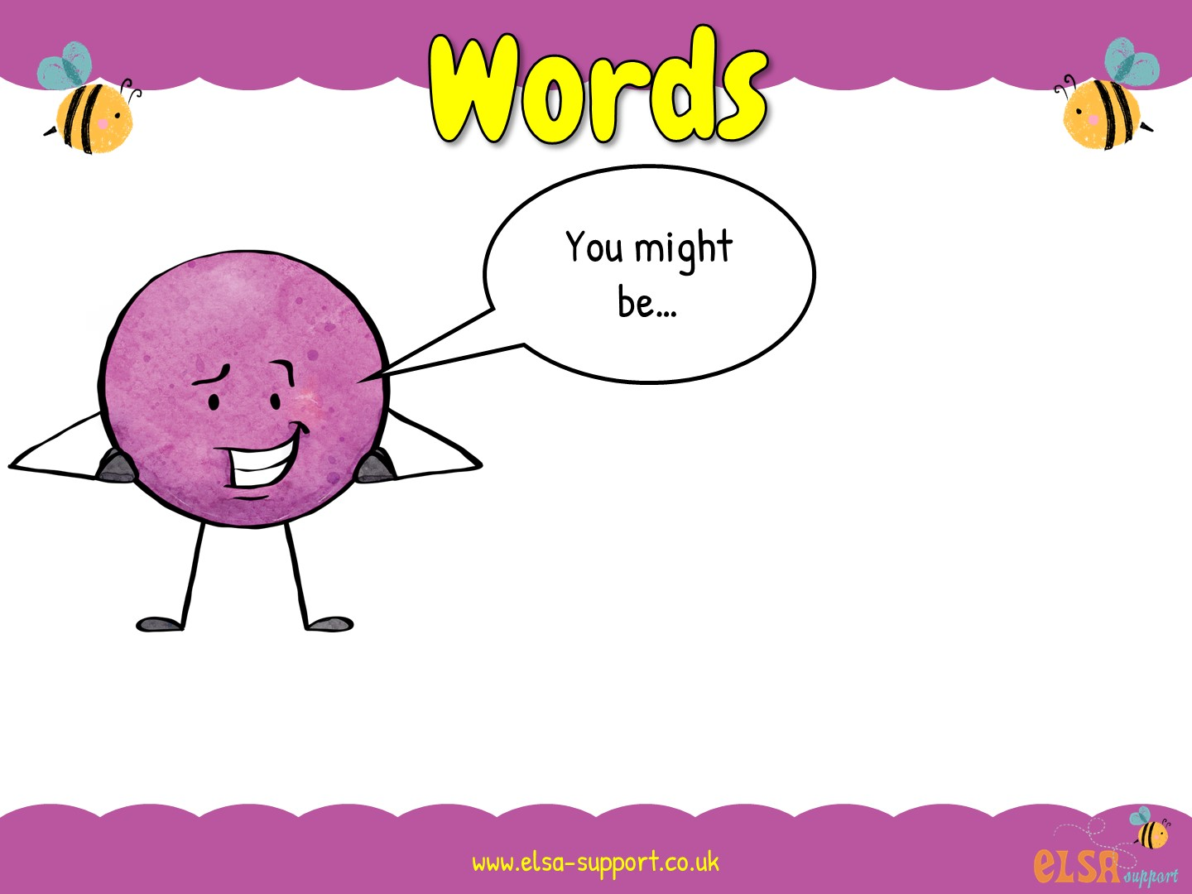
Great at sports
A fabulous artist
A number wizard
Brilliant at reading
Can you think of some abilities that you have?

Slide 7
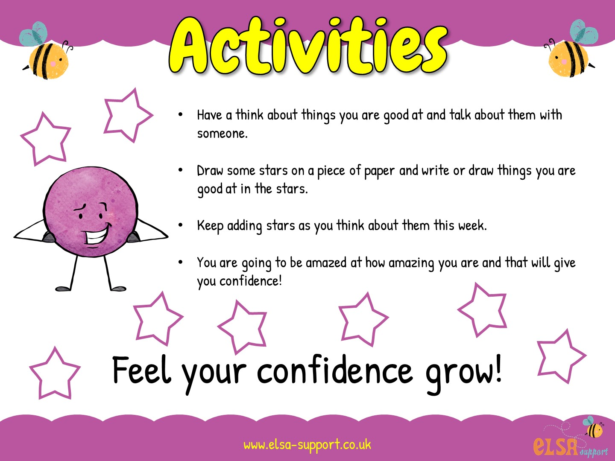

Slide 8


Slide 9


